Slide 1
Sales Analytics using SQL
Kartik Gawali

Slide 2
Problem Statement
Generate a report of individual product sales (aggregated on a monthly basis at the product code level) for Croma India customer for FY-2021 so that I can track individual product sales and run further product analytics on it in excel and also perform analysis for Markets, Products and Customers
The report should have the following fields.
Month
Product Name
Variant
Sold Quantity
Gross Price Per Item
Gross Price Total

Slide 3


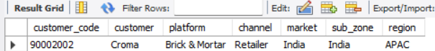
Finding customer codes for Croma India
We first find the customer code for Croma (90002002). This helps us filter only Croma’s sales data before doing any analysis.

Slide 4
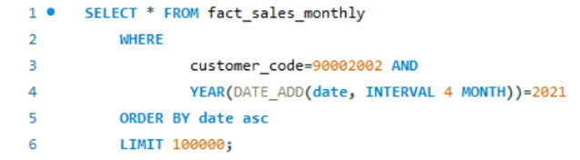
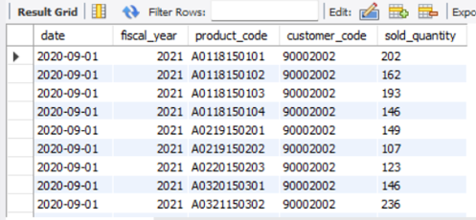
All the sales transaction data from fact_sales_monthly table for customer(croma: 90002002) in the fiscal_year 2021
This section highlights Croma India's sales performance analysis using SQL joins and aggregate functions.

Slide 5
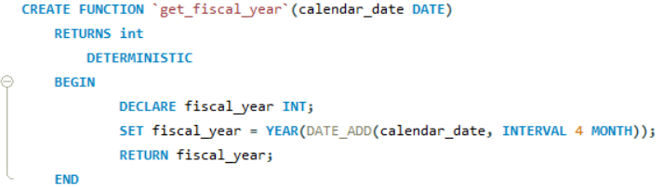
Create a function 'get_fiscal_year' to get fiscal year by passing the date
The function converts normal dates into fiscal years, which is useful for business year‑wise reports.

Slide 6
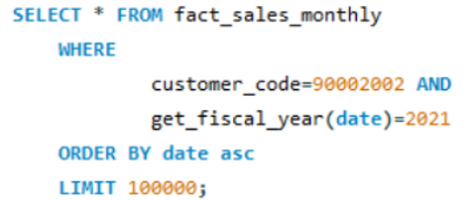
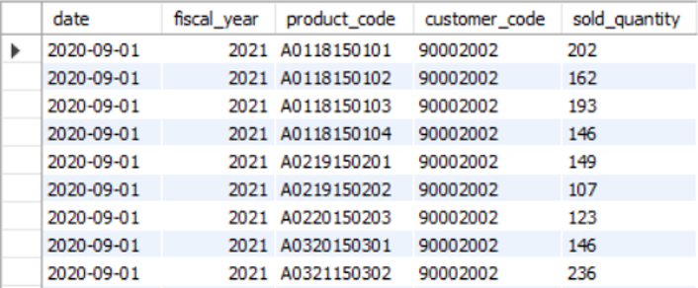
Replacing the function created

Slide 7
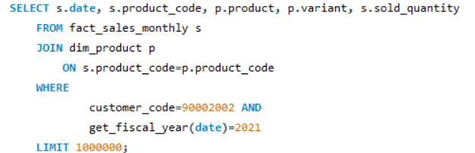
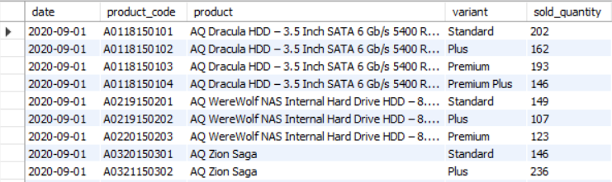
Perform joins to pull product information

Slide 8
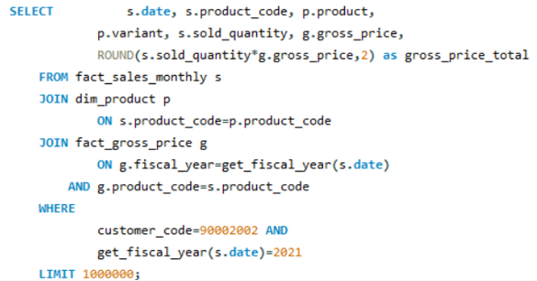
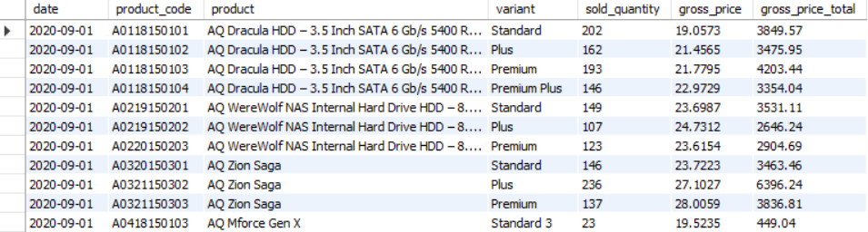
Performing join with 'fact_gross_price' table with the above query and generating required fields
Joining tables helps us combine sales data with product details like product name and category for better understanding.

Slide 9
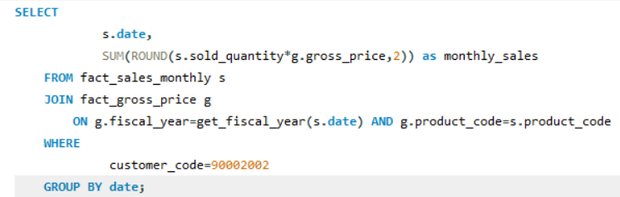
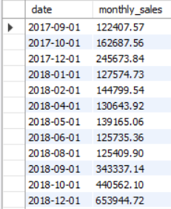
Generating monthly gross sales report for Croma India for all the years
calculates monthly gross sales for Croma India, helping evaluate performance trends across fiscal years.

Slide 10
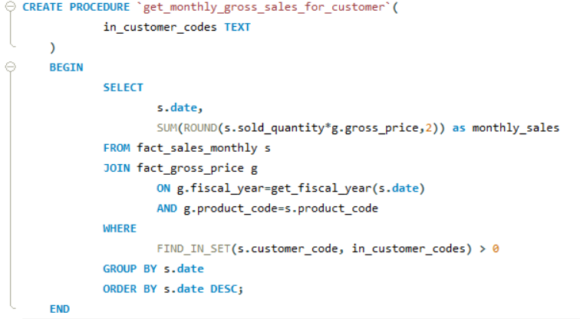
Generating monthly gross sales report for any customer using stored procedure
Stored procedures automate recurring reporting tasks and enhance reusability in SQL analytics workflows.

Slide 11
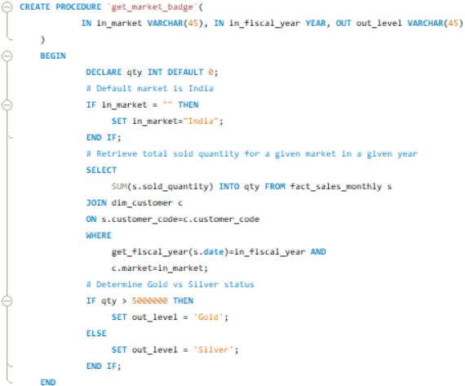
Creating a stored procedure that can retrieve market badge. i.e. if total sold quantity > 5 million that market is considered “Gold” else “Silver”
Markets selling more than 5 million units are marked as Gold, others as Silver. This helps group and compare markets easily.

Slide 12
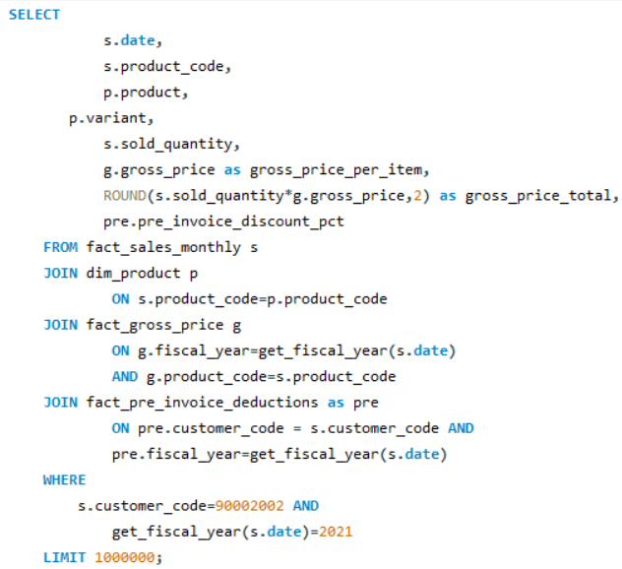
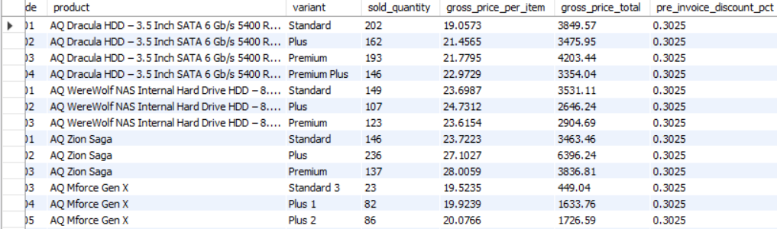
Include pre-invoice deductions in Croma detailed report
These are discounts given before invoicing. We subtract them to calculate net invoice sales more accurately.

Slide 13
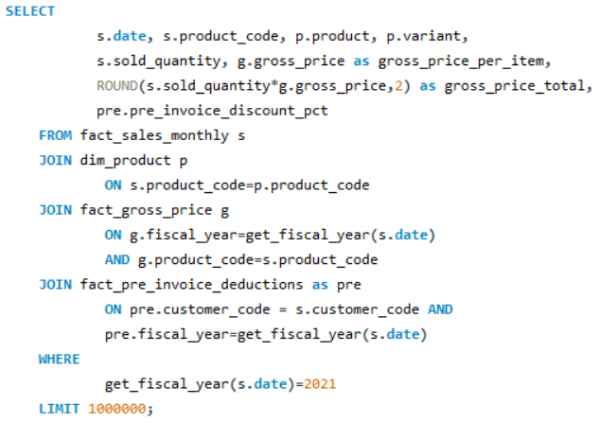
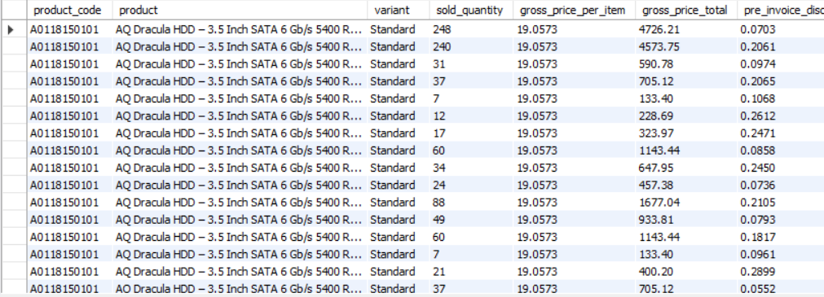
Same report but all the customers

Slide 14
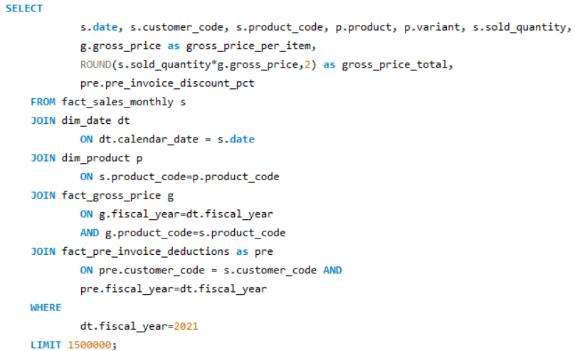
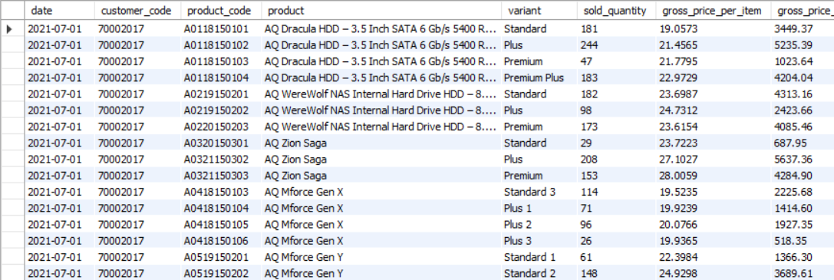
Creating dim_date and joining with this table and avoid using the function 'get_fiscal_year()' to reduce the amount of time taking to run the query

Slide 15
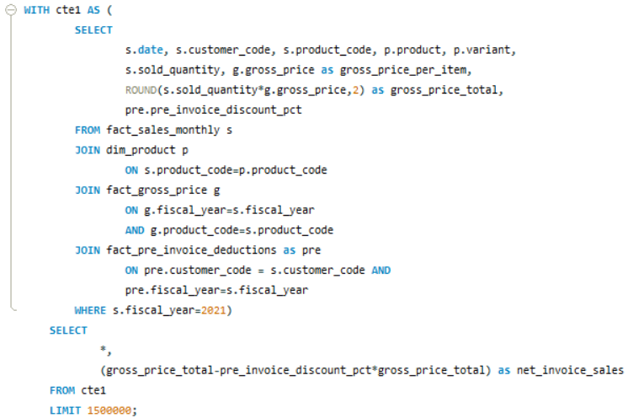
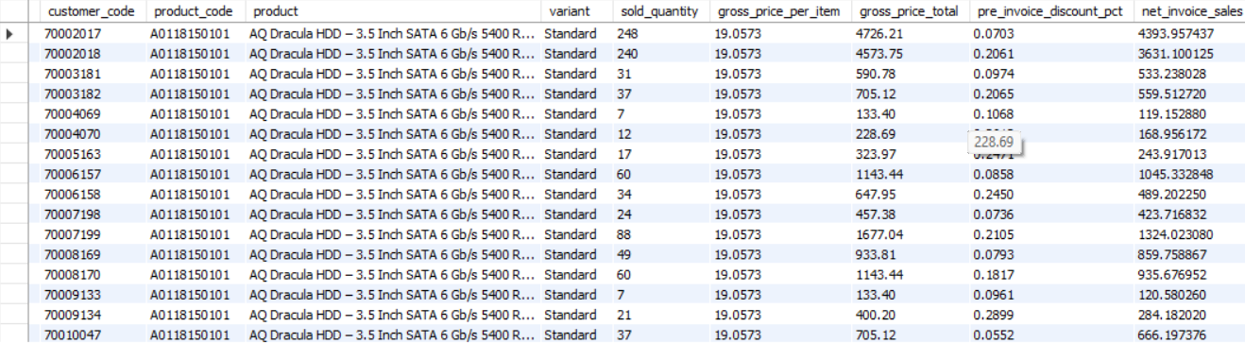
Get the net_invoice_sales amount using the CTE's
CTEs and Views help break complex queries into parts. This makes the code easier to read and faster to run.

Slide 16
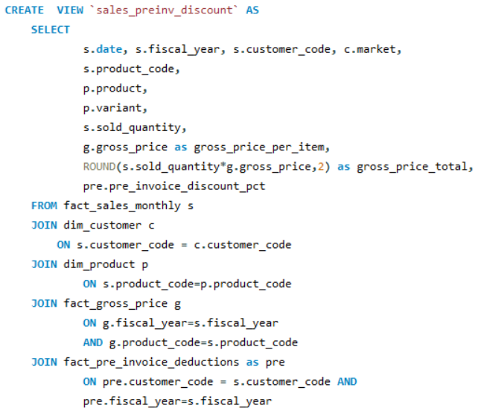
Creating the view `sales_preinv_discount` and store all the data in like a virtual table

Slide 17
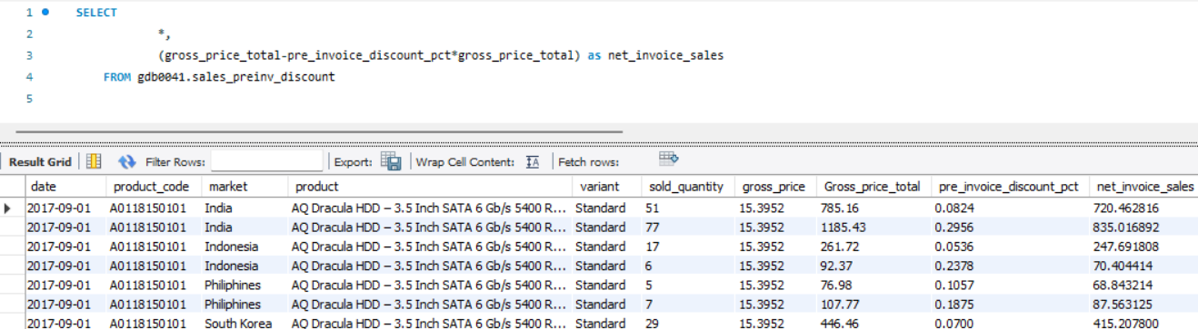
Now generate net_invoice_sales using the above created view "sales_preinv_discount"
These are discounts given after raising the invoice (like cashback etc.). They affect the final sales value.

Slide 18
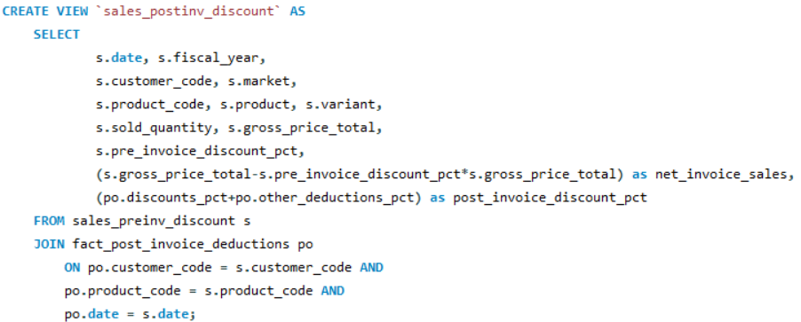
Creating a view for post invoice deductions: `sales_postinv_discount`

Slide 19
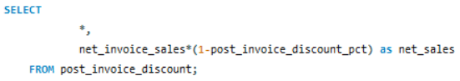
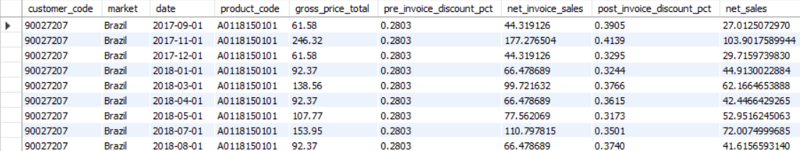
Creating a report for net sales

Slide 20
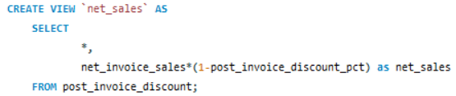
Finally creating the view `net_sales` which inbuilt use/include all the previous created view and gives the final result
The final view combines all calculations and gives the true net sales value that company earns after all deductions.

Slide 21
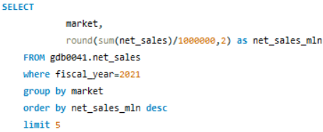
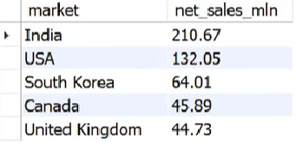
Get top 5 market by net sales in fiscal year 2021
We find top markets and products to understand where most sales come from and which products perform best.

Slide 22
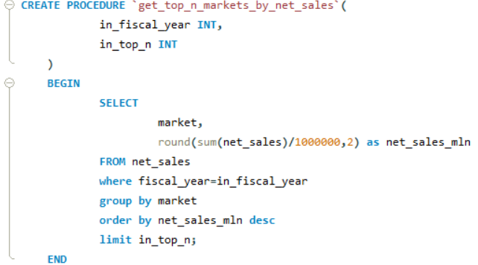
Stored procedure to get top n markets by net sales for a given year

Slide 23
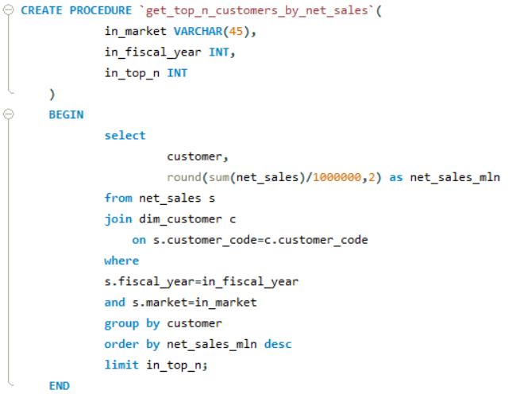
stored procedure that takes market, fiscal_year and top n as an input and returns top n customers by net sales in that given fiscal year and market

Slide 24
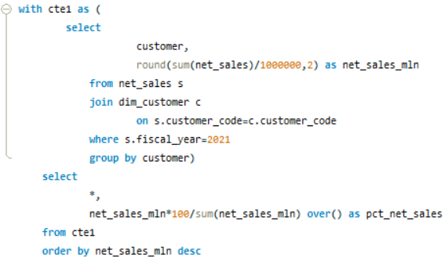
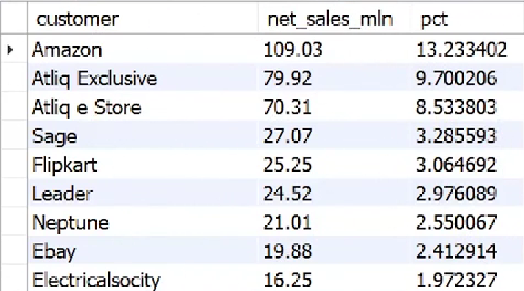
find out customer wise net sales percentage contribution

Slide 25
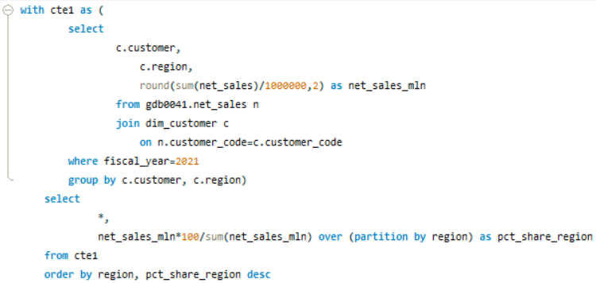
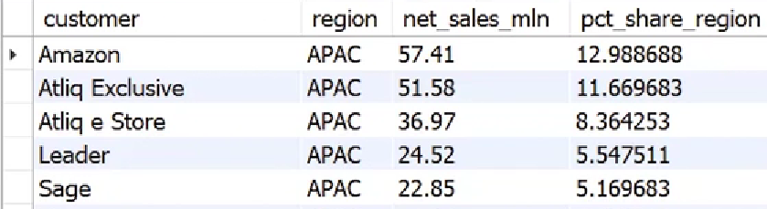
Find customer wise net sales distribution per region for FY 2021

Slide 26
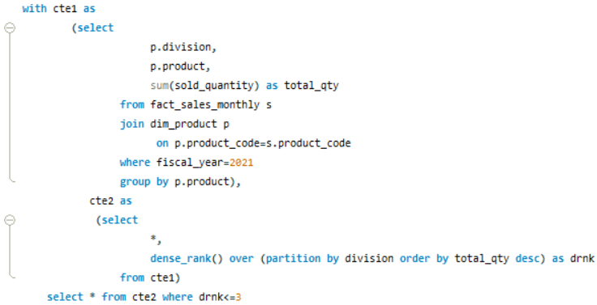
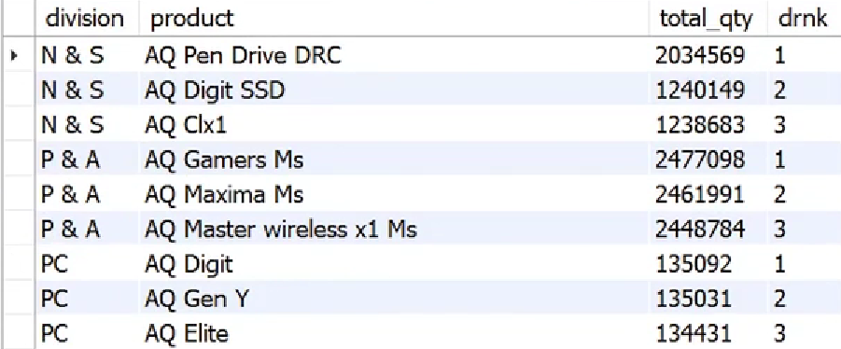
Find out top 3 products from each division by total quantity sold in a given year

Slide 27
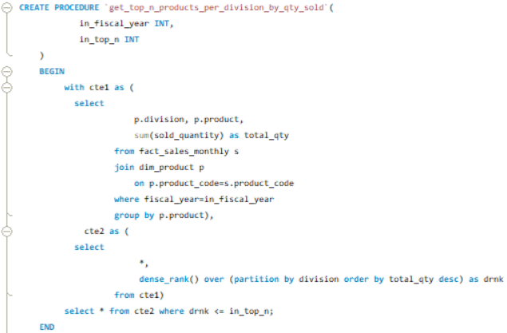
Creating stored procedure for the above query

Slide 28
Key Insights & Learnings
Created multiple SQL views and stored procedures to streamline sales analysis.
Derived customer-level net sales and performance metrics efficiently.
Applied optimization by replacing functions with joins to improve query speed.
Developed reusable SQL automation for market and customer segmentation.

Slide 29
Thank You

